Slide 1



Final Engagement
Attack, Defense & Analysis of a Vulnerable Network

Slide 2


Contents
Offensive
Defensive
Attack
Defense

Slide 3
This presentation is an overview and visual proof of the attack, defense & analysis of a Vulnerable Network We provide depth in operational reports of the engagement, these reports are available on gitlab The vulnerabilities were identified on the network using penetration testing tools and manual security analysis techniques Common Weakness Enumeration (CWE) is an industry-standard classification of types of software weaknesses or flaws CVE Risk is calculated as risk to business assets, which in-turn poses a risk to the businesses reputation and finances The Blue Team utilise Watcher in Elastic Stack to create alerts analyse and illustrate the attack The Blue Team proposes mitigations Strategies to create alarms and harden the system concerning the flaws discovered
Final Engagement – Attack, Defense & Analysis of a Vulnerable Network

Slide 4








Network Topology Targets 1 & 2
Gateway
IP 192.168.1. 1
Microsoft Azure Environment
Subnet 192.168.1.0/24
Subnet Mask 255.255.255.0
Network Watcher
Logs
ELK Server
IP 192.168.1.100
Capstone
IP 192.168.1.105
HTTP
SHH
Attack Machine
IP 192.168.1.90
Target 1
IP 192.168.1. 100
Target 2
IP 192.168.1. 115

Slide 5

Our Environment After scanning the network, we identified the hosts on our subnet:
Hostname
IP Address
Role on Network
Gateway
Kali Linux
ELK Server
Capstone
Target 1
Target 2
192.168.1.1
192.168.1.90
192.168.1.100
192.168.1.105
192.168.1.110
192.168.1.115
Hyper-V Host
Attack (Penetration Tester) Machine
Security Monitoring
Server
Vulnerable Web Server
Vulnerable Web Server

Slide 6


Red Team Enumeration Process

Slide 7

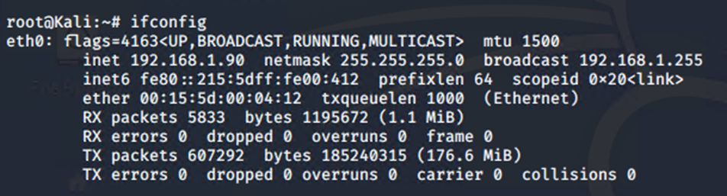
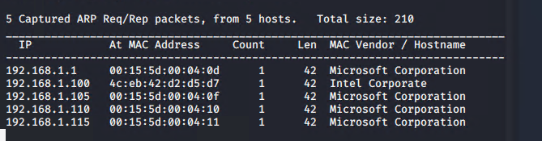
Enumeration
We begin by running ifconfig on Kali, then
using Netdiscover to scan our subnet
Command:
$ ifconfig
$ netdiscover

Slide 8
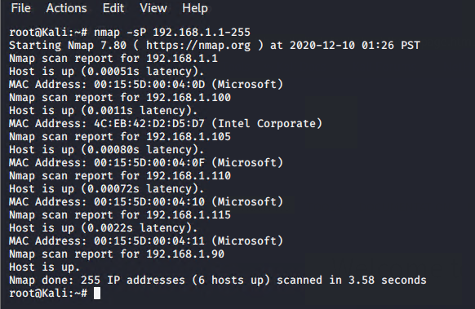
Enumeration
Then a ping sweep with Nmap for hosts discovery
Command:
$ nmap –sP 192.168.1.1-255

Slide 9

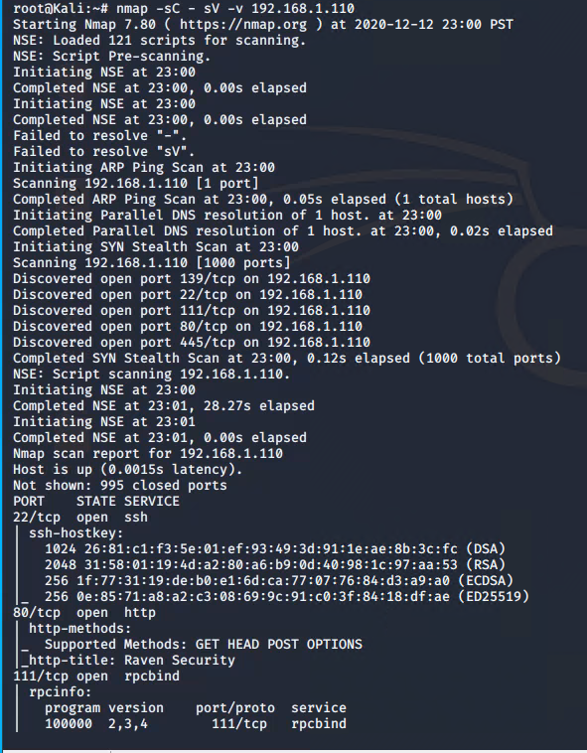
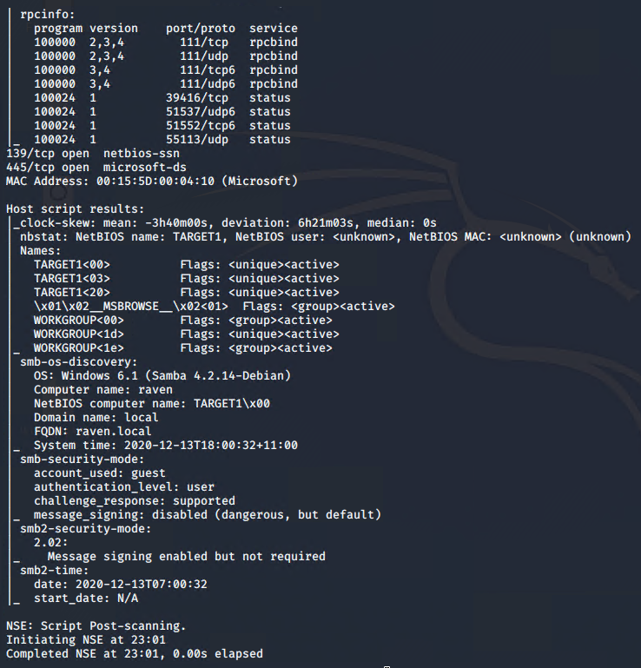

Slide 10
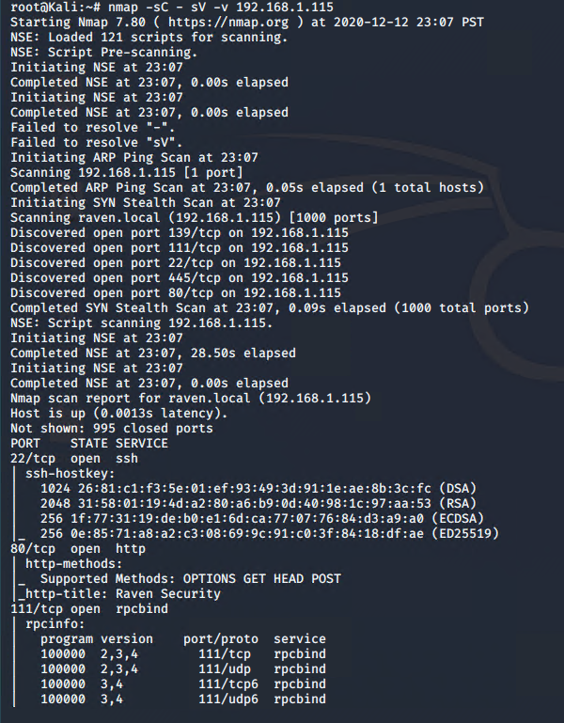
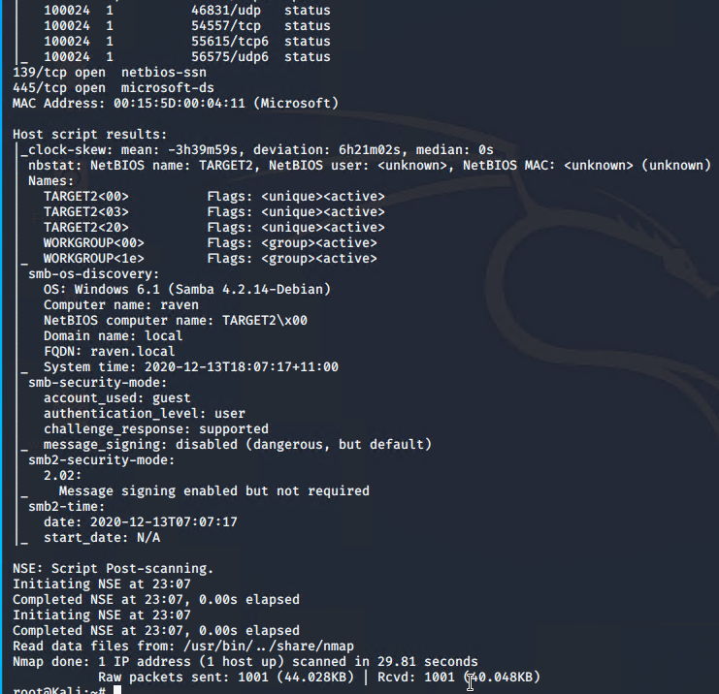

Slide 11
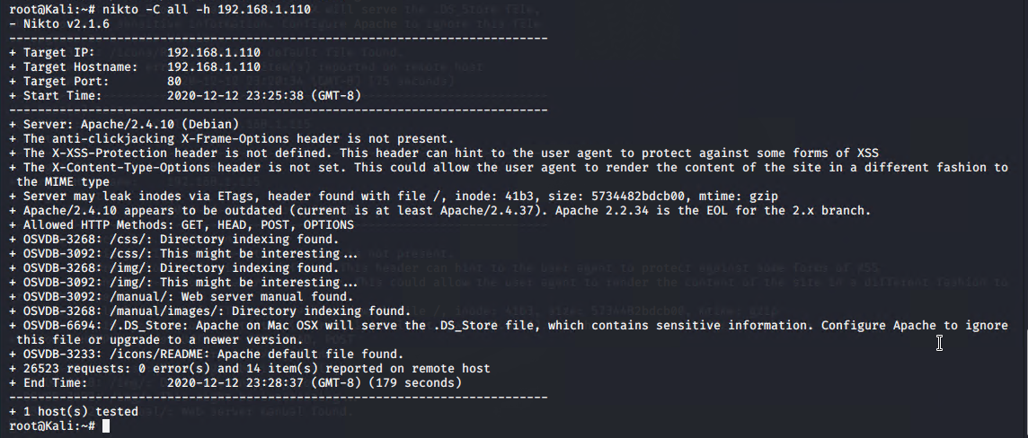
Enumeration
We use Nikto to scan Target 1
Command:
$ nikto –C all –h 192.168.1.110

Slide 12
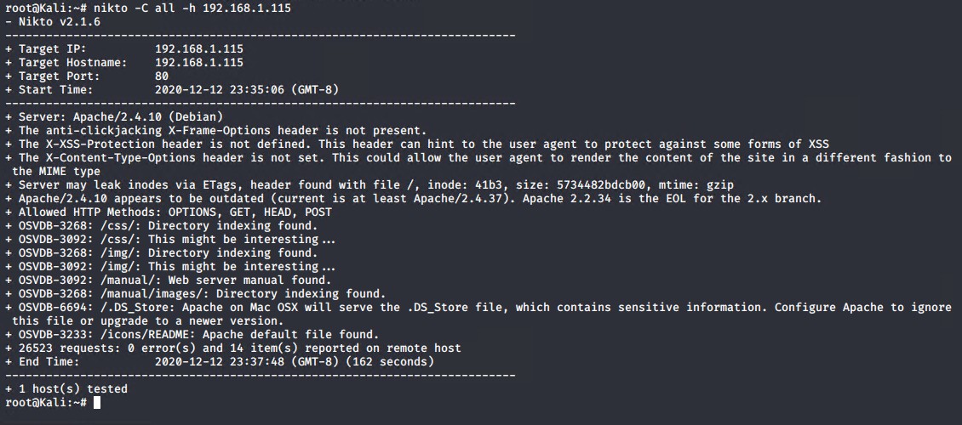
Enumeration
We use Nikto to scan Target 1
Command:
$ nikto –C all –h 192.168.1.115

Slide 13
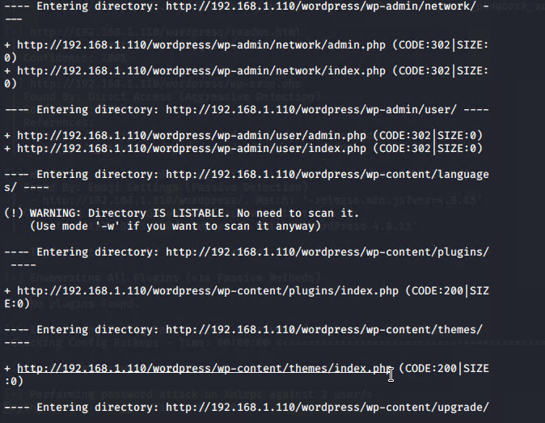
Enumeration
We use Dirb to scan Targets 1 & 2
Command:
$ dirb http://192.168.1.110

Slide 14
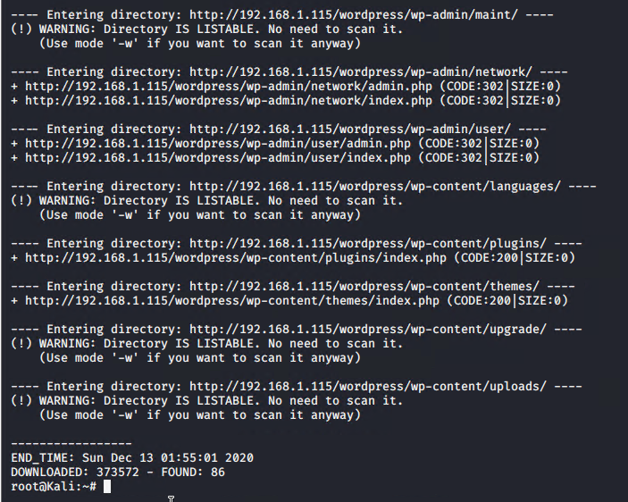
Enumeration
We use Dirb to scan Targets 1 & 2
Command:
$ dirb http://192.168.1.115

Slide 15
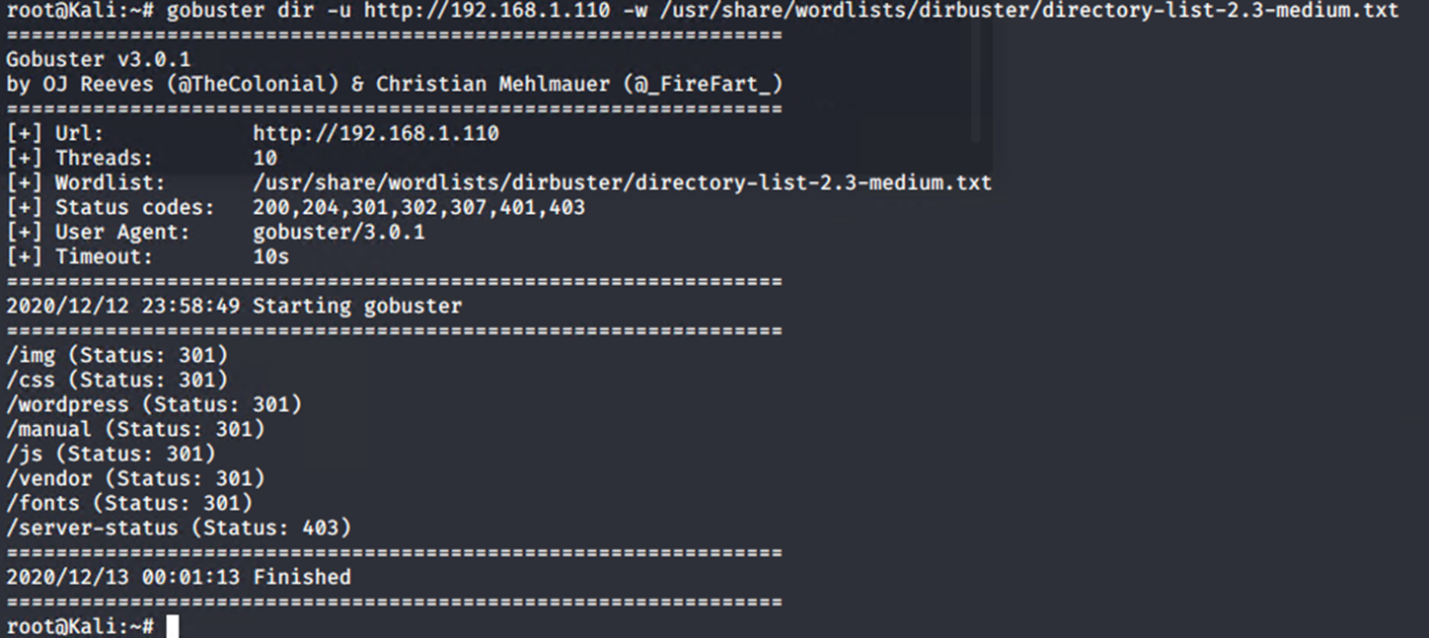
Enumeration
We use Gobuster to scan Target 1
Command:
$ gobuster dir –u http://192.168.1.110 –w /usr/share/wordlists/dirbuster/directory-list-2.3-medium.txt

Slide 16
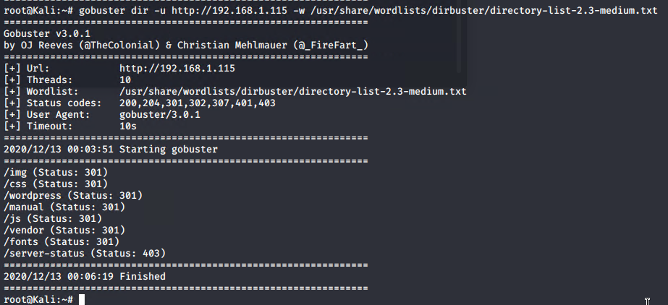
Enumeration
We use Gobuster to scan Target 2
Command:
$ gobuster dir –u http://192.168.1.115 –w /usr/share/wordlists/dirbuster/directory-list-2.3-medium.txt

Slide 17

Targets 1 & 2 Exposed Services
Our scan reveals services and OS details:
Port 22/tcp open, running ssh, version OpenSSH 6.7p1 Debian 5+deb8u4 (protocol 2)
80/tcp open, running http, version Apache httpd 2.4.10 ((Debian))
Port 111/tcp open, running rpcbind
Port 139/tcp open, running netbios-ssn Samba
Port 445/tcp open, running netbios-ssn Samba
Service info: Host: TARGET1; OS: Linux; CPE: cpe:/o:linux:linu_kernel
smb -os-discovery:
OS: windows 6.1
Computer name Raven
Domain Name: local
FQDN: raven.local
smb-security-mode:
smb2 -security-mode:
2.02:

Slide 18

Port Scan Results
Port | State | Service | Product | Version | Extra
22/tcp | open | shh | SHH | OpenSSH 6.7 | Debian
80/tcp | open | http | Apache | Apache httpd 2.4.10 | Debian
139/tcp | open | netbios-ssn | Samba | 4.2.14 | SMB 2.02
445/tcp | open | netbios-ssn | Samba | 4.2.14 | SMB 2.02
111/tcp | open | rpcbind | Portmapper | 4
111/udp | open | rpcbind | Portmapper | 3
111/tcp6 | open | rpcbind | Portmapper | 2
111/udp6 | open | rpcbind | Portmapper | 4
39416/tcp | open | status |  | 1
51537/udp6 | open | status |  | 1
51552/tcp6 | open | status |  | 1
55113 | open | status |  | 1

Slide 19
Information Exposure Through Directory Listing
Targets 1 & 2
CWE-548 Risk Category: Information Scope: Confidentiality Likelihood of Exploitation: Medium to High Member of: OWASP A6:2017-Security Misconfiguration | Description: A directory listing is inappropriately exposed, yielding potentially sensitive information to attackers Impact: Exposing the contents of a directory can lead to an attacker gaining access to source code or providing useful information for the attacker to devise exploits, such as creation times of files or any information that may be encoded in file names. The directory listing may also compromise private or confidential data Potential Mitigations Phases: Architecture and Design; System Configuration Recommendations include restricting access to important directories or files by adopting a need to know requirement for both the document and server root, and turning off features such as Automatic Directory Listings that could expose private files and provide information that could be utilized by an attacker when formulating or conducting an attack
Sources:
https://cwe.mitre.org/data/definitions/548.html
https://cwe.mitre.org/data/definitions/1032.html
https://owasp.org/www-pdf-archive/OWASP_Top_10-2017_%28en%29.pdf.pdf

Slide 20
Improper Access Control (parent of) Improper Privilege Management
Targets 1 & 2
CWE-284 / CWE-269 Risk Category: Confidentiality Integrity Availability Scope: Access Control Likelihood of Expliotation: Medium to High Member of: OWASP API9:2019 Improper Assets Management | The software does not restrict or incorrectly restricts access to a resource from an unauthorized actor Access control involves the use of several protection mechanisms such as: Authentication (proving the identity of an actor) Authorization (ensuring that a given actor can access a resource), and Accountability (tracking of activities that were performed) Impact: Gain Privileges or Assume Identity Potential Mitigations Phases: Architecture and Design; Operation Very carefully manage the setting, management, and handling of privileges. Explicitly manage trust zones in the software
Source:
https://cwe.mitre.org/data/definitions/284.html
https://cwe.mitre.org/data/definitions/284.html
https://owasp.org/www-project-api-security/

Slide 21
Unrestricted Upload of File with Dangerous Type
Targets 1 & 2
CWE-434 Scope: Integrity Confidentiality Availability Likelihood Of Exploit Medium to High Member of: 2020 CWE Top 25 Most Dangerous Software Weaknesses | Description: The software allows the attacker to upload or transfer files of dangerous types that can be automatically processed within the product's environment Impact: Arbitrary code execution is possible if an uploaded file is interpreted and executed as code by the recipient. This is especially true for .asp and .php extensions uploaded to web servers because these file types are often treated as automatically executable, even when file system permissions do not specify execution. For example, in Unix environments, programs typically cannot run unless the execute bit is set, but PHP programs may be executed by the web server without directly invoking them on the operating system Potential Mitigations: Phase: Implementation Strategy: Input Validation Assume all input is malicious. Use an "accept known good" input validation strategy, i.e., use a list of acceptable inputs that strictly conform to specifications. Reject any input that does not strictly conform to specifications, or transform it into something that does.
Sources:
https://cwe.mitre.org/data/definitions/434.html

Slide 22
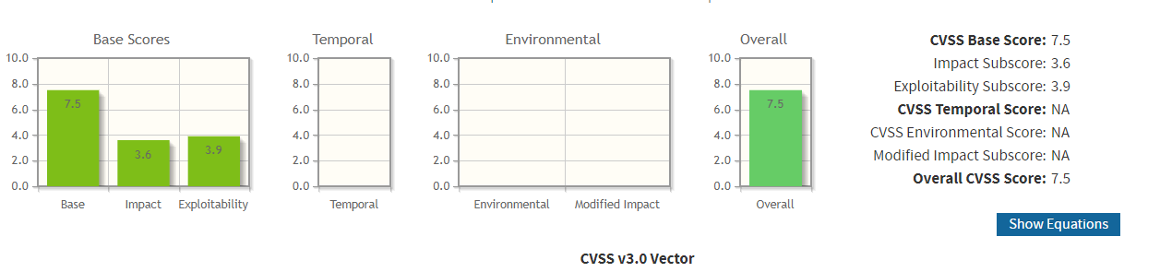
CVE-2016-6515
Targets 1 & 2
HIGH Port 22 SHH | The auth_password function in auth-passwd.c in sshd in OpenSSH before 7.3 does not limit password lengths for password authentication, which allows remote attackers to cause a denial of service (crypt CPU consumption) via a long string

Slide 23
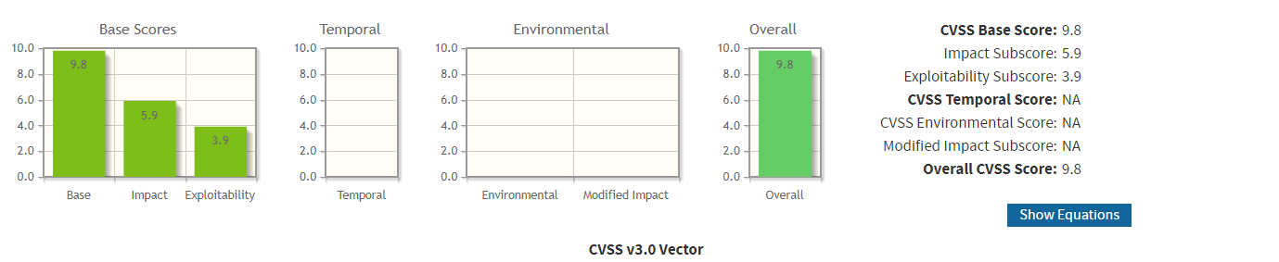
CVE-2016-6662
Targets 1 & 2
CRITICAL MySQL | Oracle MySQL allows local users to create arbitrary configurations and bypass certain protection mechanisms by setting general_log_file to a my.cnf configuration. NOTE: this can be leveraged to execute arbitrary code with root privileges by setting malloc_lib

Slide 24
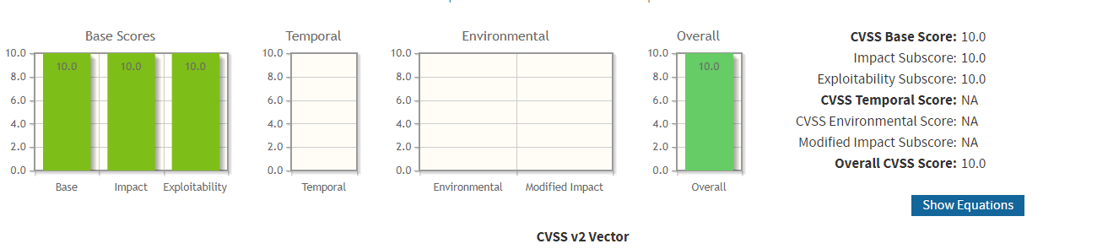
CVE-2007-5580
Targets 1 & 2
CRITICAL Port 139, 445 SMB 2.0.2 | Buffer overflow in a certain driver in Cisco Security Agent 4.5.1 before 4.5.1.672, 5.0 before 5.0.0.225, 5.1 before 5.1.0.106, and 5.2 before 5.2.0.238 on Windows allows remote attackers to execute arbitrary code via a crafted SMB packet in a TCP session on port (1) 139 or (2) 445.

Slide 25
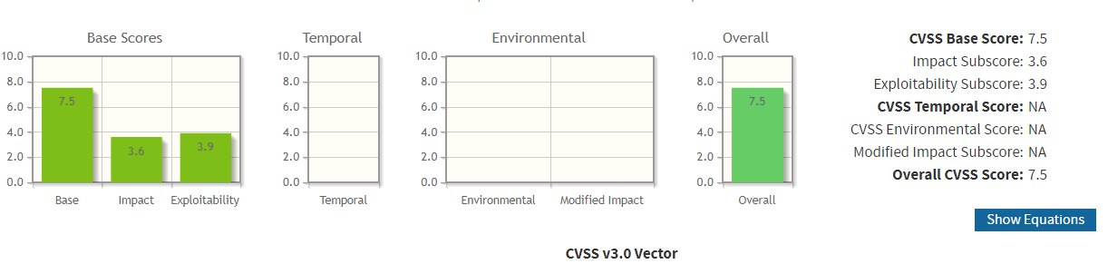
CVE-2017-8779
Targets 1 & 2
HIGH Port 111 RPCBind | Portmapper is an RPC service, which always listens on tcp and udp 111, and is used to map other RPC services A small request (~82 bytes via UDP) sent to the Portmapper generates a large response (7x to 28x amplification), which makes it a suitable tool for DDoS attacks, especially considering its prevalence among all the modern Unix systems

Slide 26
Red Team Exploitation Process

Slide 27
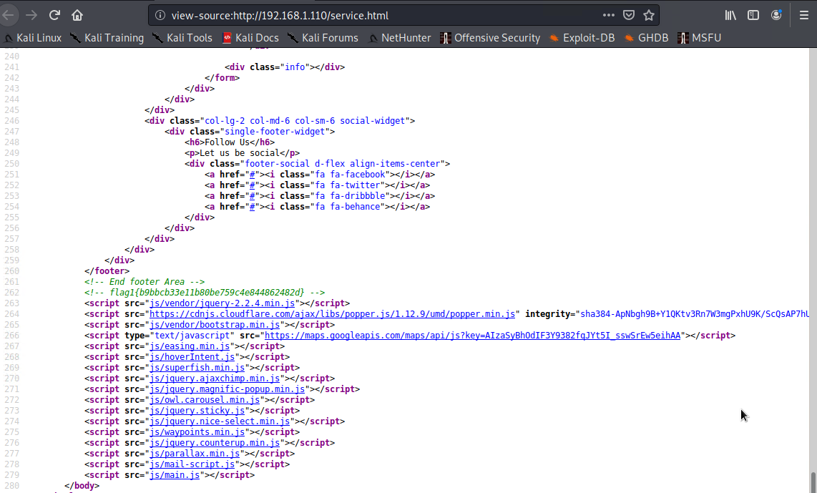
Target 1 Raven
Port 80 open, running HTTP Apache Server
Word Press site Raven Security
We view the source code on each page – the service page reveals FLAG 1

Slide 28
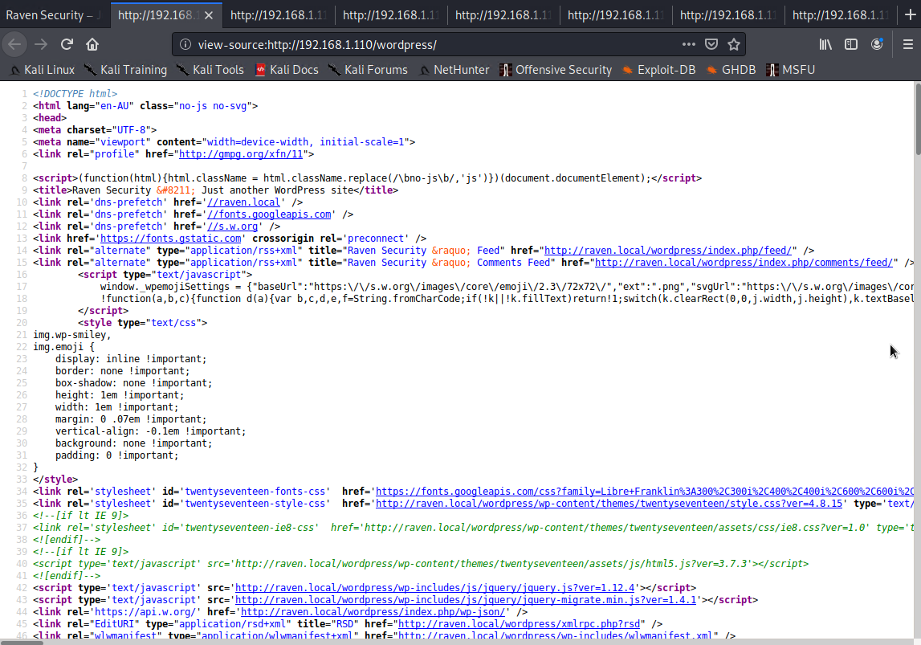
Target 1 Raven

Slide 29
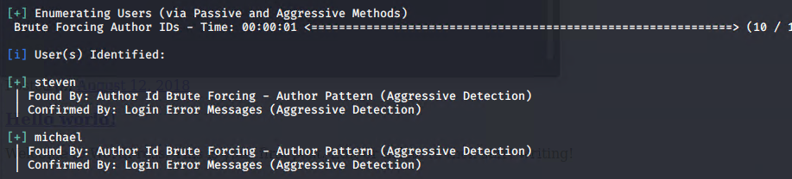
Target 1 Raven
Enumerate the Word Press Site with WP Scan for users and vulnerable plugins
We discover two users, no vulnerable plug ins

Slide 30
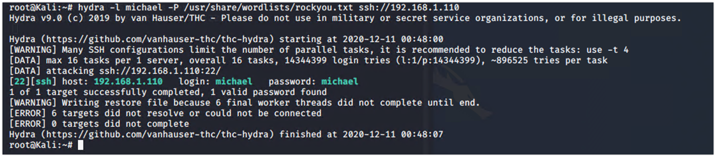
Target 1 Raven
Bruteforce ssh, users steven micheal and root
No luck with steven or root however we successfully obtain Michaels ssh credentials

Slide 31
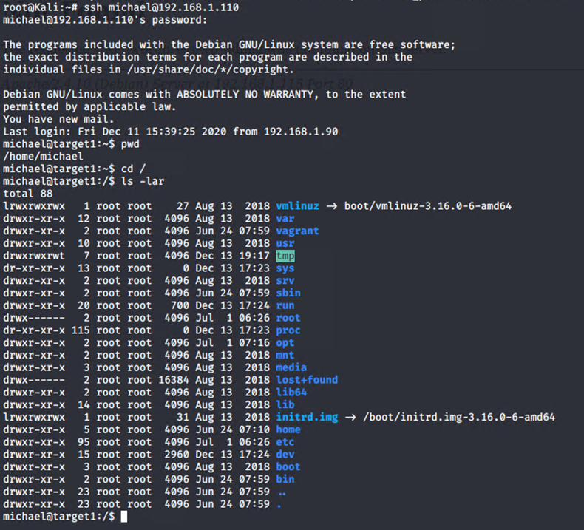
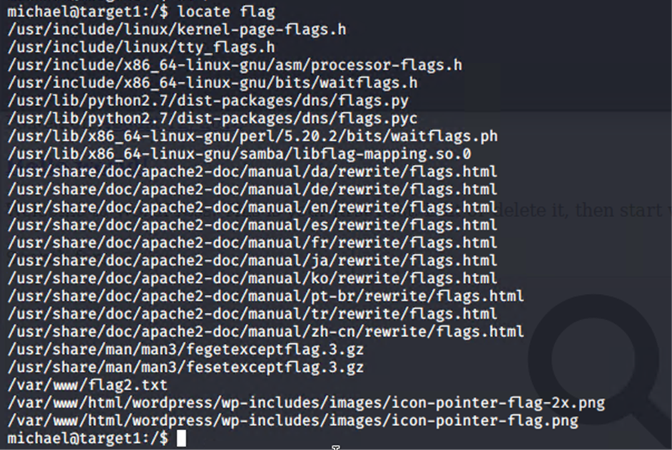
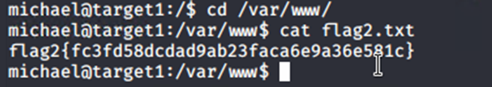
Target 1 Raven
We SHH into our target with user Michael credentials
Success, login and find flag 2

Slide 32
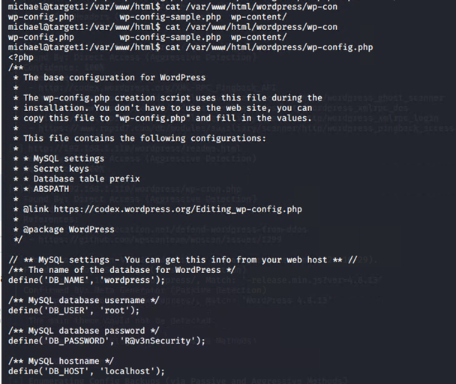
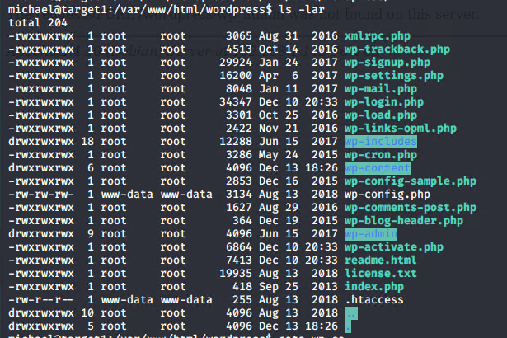
Target 1 Raven
Navigate through Michaels account we investigate
Emails from root going to user using php mailer
Check sudo privileges and look for privilege escalation credentials
We uncover database credentials for MySQL

Slide 33
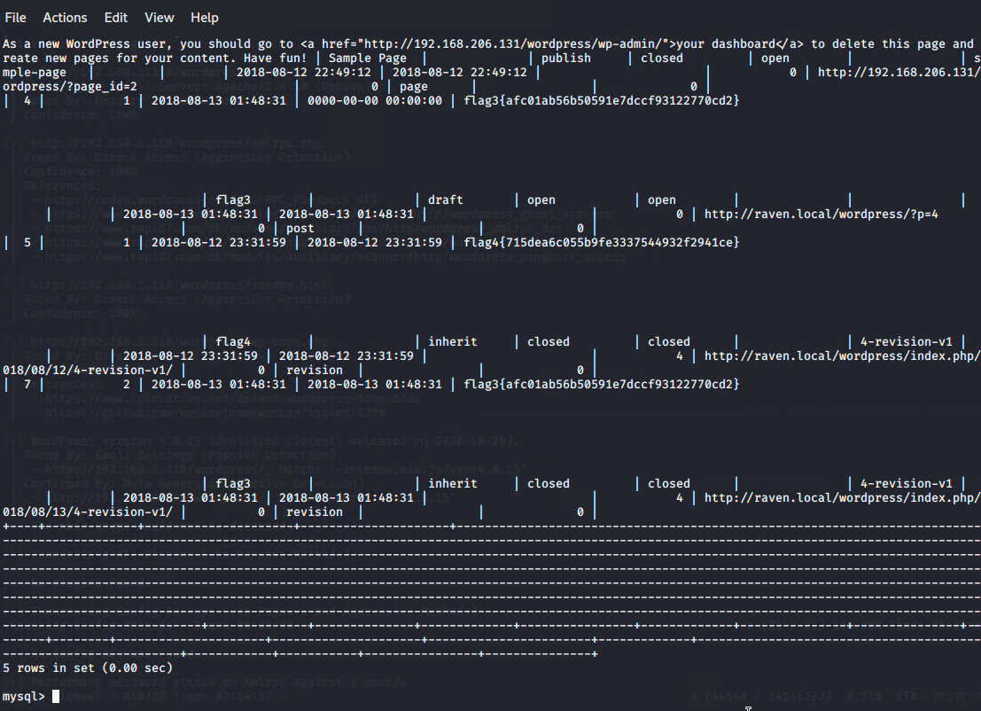
Target 1 Raven
With access to MySQL Database
We locate FLAGS 3 & 4

Slide 34
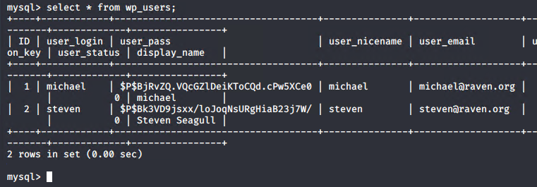
Target 1 Raven
With access to MySQL Database
We find user Michael & Steven password hashes
And FLAGS 3 & 4

Slide 35
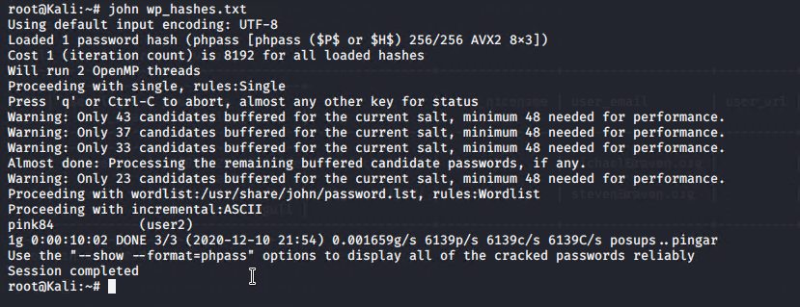
Target 1 Raven
After dumping user Steven password hash into a file we use John to crack our hash
Success! User Steven password is cracked

Slide 36
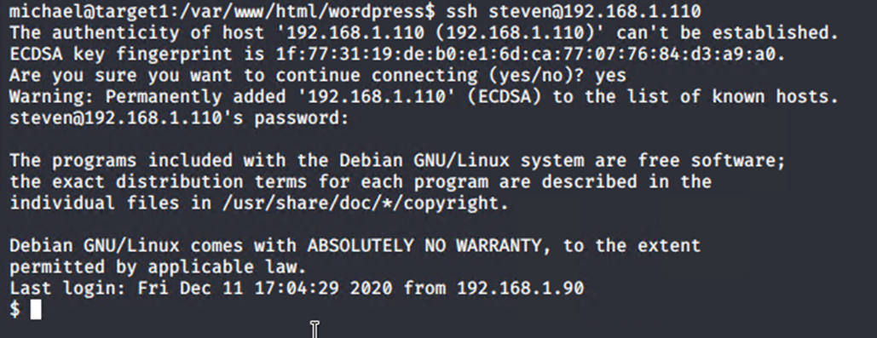
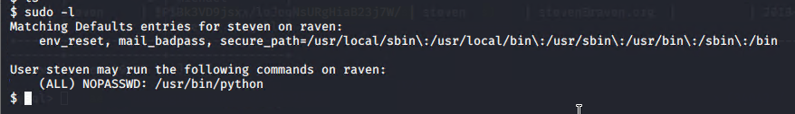
Target 1 Raven
SSH in with user Steven credentials
And check sudo permissions

Slide 37
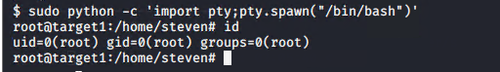
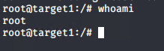
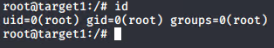
Target 1 Raven
We use python to ‘spawn’ a shell terminal
Our shell is spun up and we have Root!

Slide 38


Red Team Conclusion Target 1
We successfully gain access to our target via different brute forcing methods.
SSH provided an entry point and our vuln WordPress config file provided easy access to MySQL Database where we gain user Steven password hash.
Again, SSH is an entry point where we discover user Steven sudo privileges allow running python without a password.
We use Python to spawn a pty shell, and successfully su to root and gain ROOT ACCESS
Along the way we found all four flags complete the mission!

Slide 39

Target 2 Raven
We head to our target IP 192.168.1.115 as we already know our target is running a HTTP Apache Server with a WordPress Site
We navigate through the pages and source code – nothing stands out here

Slide 40
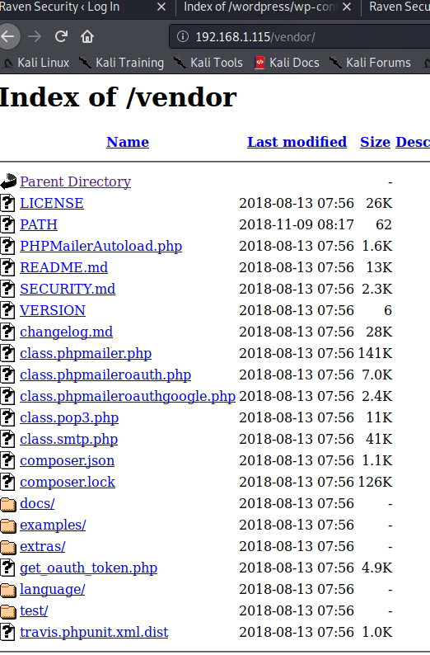
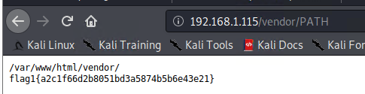
Target 2 Raven
We go through our earlier dirb and gobuster scan along with some helpful research into WordPress sites
The vendor directory uncovers some interesting files
FLAG 1 discovered

Slide 41
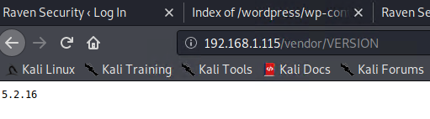
Target 2 Raven
We take a look at the rest of the files and notice the PHPMailer
Version number 5.2.16 could be the PHPMailer version number

Slide 42
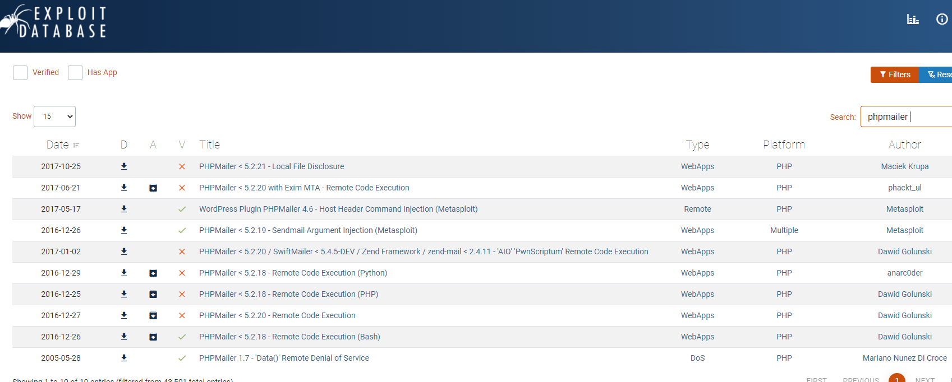
Target 2 Raven
Exploit Database shows that PHP Mailer is vulnerable to Remote Code execution via PHP

Slide 43
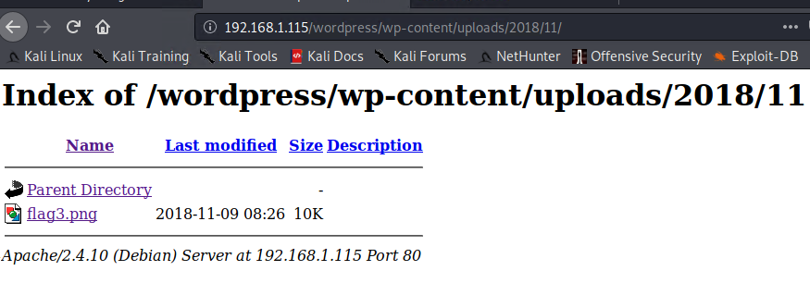
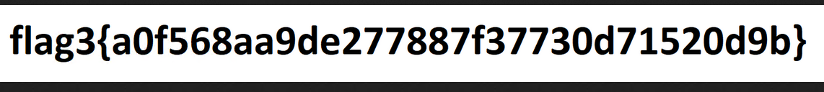
Target 2 Raven
We check wp-content/uploads
and discover FLAG3

Slide 44
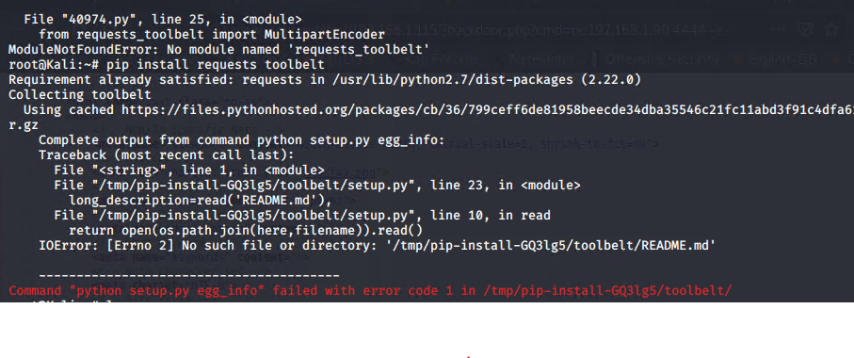
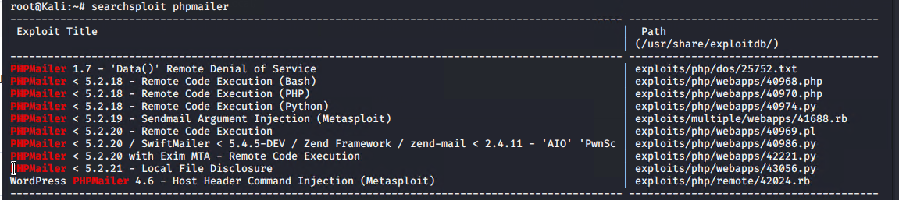
Target 2 Raven
PHPMailer
Exploit

Slide 45
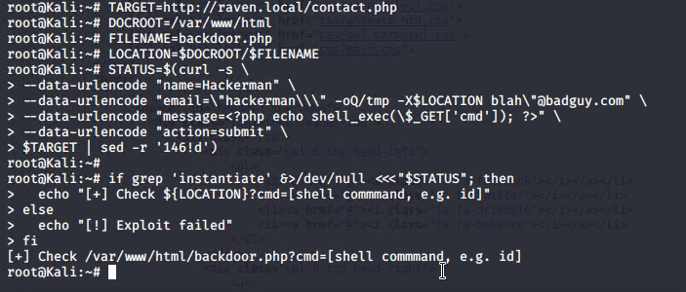
Target 2 Raven
We customise the backdoor script and run though the command line directed at our target
command runs successfully – lets check the backdoor

Slide 46
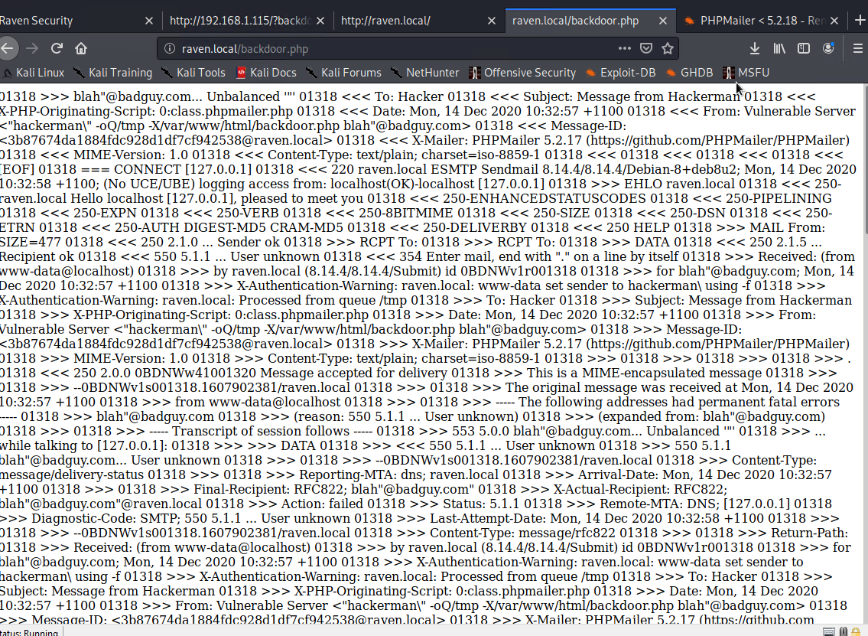
Target 2 Raven
Our backdoor was successful

Slide 47
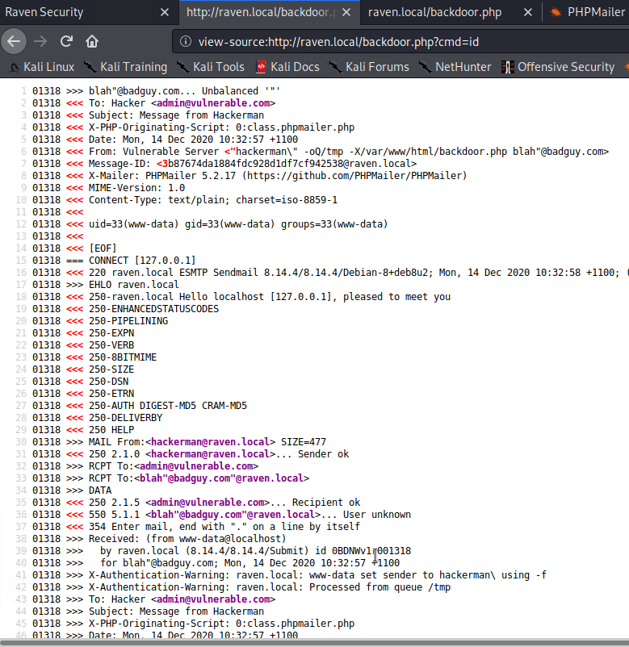
Target 2 Raven
We check the location of the backdoor and the privileges

Slide 48
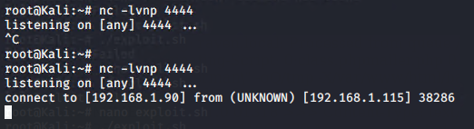
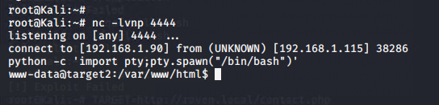
Target 2 Raven
We use ncat to start a listener, then using our earlier python script, we spawn a shell

Slide 49
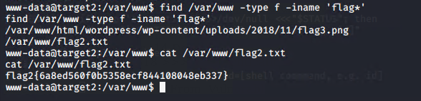
Target 2 Raven
We locate FLAG 2 in the /var/www directory

Slide 50
Tools Used in Exploitation Process
Netdiscover is a network address discovering tool that was developed mainly for those wireless networks without DHCP servers, though it also works on wired networks. It sends ARP requests and sniffs for replies.
Nmap is short for Network Mapper. It is an open-source Linux command-line tool that is used to scan IP addresses and ports in a network and to detect installed applications.
Wpscan WPScan is a black box WordPress vulnerability scanner that can be used to scan remote WordPress installations to find security issues
Gobuster Gobuster is a tool used to brute-force like URIs (directories and files) in web sites, DNS subdomains (with wildcard support) and Virtual Host names on target web servers.and Virtual Host names on target web servers.
DIRB is a Web Content Scanner. It looks for existing (and/or hidden) Web Objects. It basically works by launching a dictionary-based attack against a web server and analyzing the response.
John the Ripper (JtR) is a password cracking tool originally produced for UNIX-based systems. It was designed to test password strength, brute-force encrypted (hashed) passwords, and crack passwords via dictionary attacks.
Hydra is a parallelized login cracker which supports numerous protocols to attack. It is very fast and flexible, and new modules are easy to add. This tool makes it possible for researchers and security consultants to show how easy it would be to gain unauthorized access to a system remotely.
Nikto is an Open Source web server scanner which performs comprehensive tests against web servers for multiple items, including over 6700 potentially dangerous files/programs, checks for outdated versions of over 1250 servers, and version specific problems on over 270 servers. It also checks for server configuration items such as the presence of multiple index files, HTTP server options, and will attempt to identify installed web servers and software. Scan items and plugins are frequently updated and can be automatically updated.
Python pty — Pseudo-terminal utilities Spawn a process, and connect its controlling terminal with the current process’s standard io. This is often used to baffle programs which insist on reading from the controlling terminal. It is expected that the process spawned behind the pty will eventually terminate, and when it does spawn will return.

Slide 51

Blue Team Process

Slide 52

Blue Team Our Targets
Host Name | Purpose | IP Address | Netbios Name | Operating System | Domain Name | FQDN
Raven | Webserver | 192.168.1.100 | TARGET1 | Windows 6.1 | Local | Raven.local
Host Name | Purpose | IP Address | Netbios Name | Operating System | Domain Name | FQDN
Raven | Webserver | 192.168.1.115 | TARGET2 | Windows 6.1 | Local | Raven.local

Slide 53
ELK Stack & Watcher
Traffic to these services should be carefully monitored. To this end, we have implemented the alerts below:
Anything searchable in the logs is able to be created as a watch, the watch alerts itself has five components:
1. trigger – watch execution schedule, what time or how often in which to run alert
2. input – indices ie. “apache_logs” against our request ie. “etc/passwd”
3. condition – where the watch payload is tested against the watch payload ie. “ctx.payload.hits.total” : { “gt” : 0
4. transform – outcome
5. actions – if the watch condition is met we can trigger our alert to send an email/text or index back to elastic search

Slide 54
Alert Metrics
Excessive HTTP Errors is implemented as follows:
Metric: http.response.status.code
Threshold: Grouped over top 5 for the last five minutes
Vulnerability Mitigated: Denial of Service Attack or Brute Force attacks
Reliability: This alert is Highly Reliable, the alert fired during scans
HTTP Request Size Monitor is implemented as follows:
Metric: http.response.body.bytes
Threshold: sum of bytes is above 3500 for a minute
Vulnerability Mitigated: Payload Delivery Attempt
Reliability: Highly reliable if baseline and thresholds set properly
Failed login attempts is implemented as follows:
Metric: request run against auth-logs where the login outcome was failed password
Threshold: More then 10 failed login in attempts from the same source IP in the last 5mins (interval every 10 secs)
Vulnerability Mitigated: Bruteforce login attempts
Reliability: This alert is Highly Reliable, the alert fired during scans

Slide 55
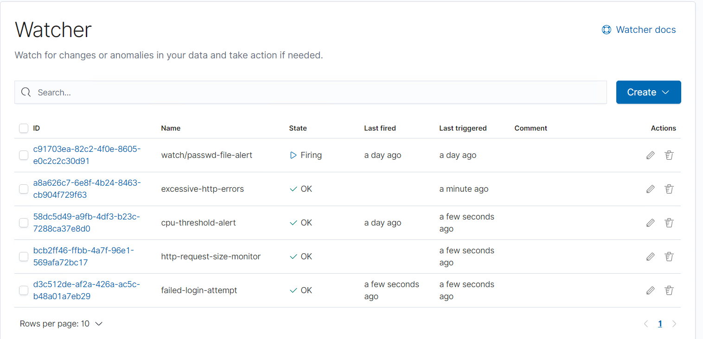
Watcher Alerts

Slide 56
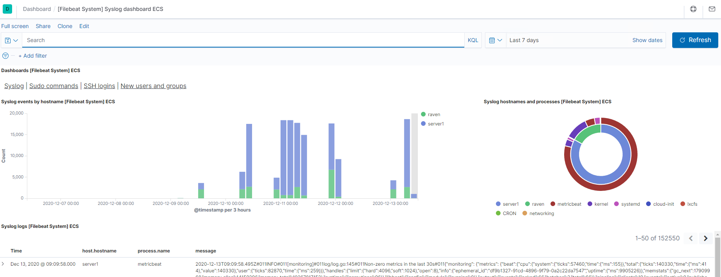
System Logs

Slide 57

Sudo Commands

Slide 58

SSH Login Attempts

Slide 59
General Recommendations
Hardening System
· Enable the fail2ban to protect against brute force attacks
· Patch everything: Keep your systems up-to-date to avoid exploits of known vulnerabilities
· No single point of failure: Whether it’s ransomware, malware, hardware failure, database error, or something else. If your data is important, then it should be backed up, at least one other secure location
· Use a firewall or endpoint protection: Most solutions will include a blacklist of known attacker IP addresses
· Use a virtual private network (VPN): VPNs encypt and protect network traffic
· Implement virtual local area networks (VLANs): VLANs can be used to isolate internal network traffic
· Use MAC address filtering: This can prevent unknown systems from accessing your network.

Slide 60
MySQL & SSH Hardening
MySQL
· Patch: Update MySQL
· Why: Version has a critical known vulnerabilities
· Fix: https://dev.mysql.com/downloads/mysql/
· Patch: Harden the MySQL server install
· Why: MySQL offers a handy command that goes a very long way to improve the security of your MySQL installation
SSH
· Patch: Update SSH to latest version
· Why: the version 6.9 has known vulnerabilities

Slide 61
Passwords & Firewall
Hardening
Password Strength
· Patch: Force user Michael password to expire immediately and lock him out as an SSH user
Weak Encryption
· Patch: Changing Password Complexity
· Why: It works against brute force dictionary- based attacks such as Hydra and John the Ripper
· Open Ports / Inadequate Firewall
· Patch: Setup a firewall to deny all traffic before enabling ports 80 and 22 only
· Why It Works: This works because it prevents leaving open ports

Slide 62
Apache Server Hardening
Patch: Update system to latest version
Why: Current install has known vulnerabilities
Patch: Reconfigure to HTTP Strict Transport Security (HSTS)
Why: The Strict-Transport-Security header is a security enhancement that restricts web browsers to access web servers solely over HTTPS. This ensures the connection cannot be establish through an insecure HTTP connection which could be susceptible to attacks.
Fix: In order to enable HSTS on your Apache server, you must edit your configuration file and add the following to Virtual Host.
Patch: Enable X-frame Options Header
Why: The X-Frame-Options header provides clickjacking protection by not allowing iframes to load on your website
Patch: Enable X-XXS-Protection
Why: According to CVE details, there have been over 9,903 major XSS attacks recorded. After DDoS and code execution, XSS attacks are very common.
Patch: Enable X-content-Type_Options
Why: The X-Content-Type-Options header is used to protect against MIME sniffing vulnerabilities. These vulnerabilities can occur when a website allows users to upload content to a website however the user disguises a particular file type as something else. This can give them the opportunity to perform cross-site scripting and compromise the website
Fix: For Apache users, simply add the following snippet to your .htaccess file. Once done, save your changes.
$ Header set X-Content-Type-Options "nosniff"

Slide 63
SMB and NetBIOS Ports 139 & 445
Disable NetBios/NetBT and SMB services if you are not using them
• Patch: Update SMB to newest version
• Why: Version 2.0.2 has known vulnerabilities
• Patch: Block Port 445 at the firewall level
• Why: To prevent access from outside, Ports 135-139 and 445 are not safe to publicly expose and have not been for a decade
• Patch: Disable NetBIOS over TCP/IP
• Why: This procedure forces all SMB traffic to be direct hosted using only port 445

Slide 64
WordPress Site Hardening
• Patch: Use Strong Passwords – Force strong passwords on your users
• Patch: Multi-factor Authentication – If your password got compromised, the user would still need to have the verification code from your phone.
• Patch: Limit Login Attempts – This plugin allows you to lock the user out after X numbers of failed login attempts.
• Patch: Disable Theme and Plugin Editors – This prevents user escalation issues. Even if the user’s privileges were escalated, they couldn’t modify your theme or plugins using the WP-Admin.
• Patch: Password Protect WP-Admin – You can password protect the entire directory. You can also limit access by IP.
• Patch: Disable PHP Execution in WordPress Directories – This disables PHP execution in the upload directories and other directories of your choice. Basically so even if someone was able to upload the file in your uploads folder, they wouldn’t be able to execute it.

Slide 65
The End

